Slide 1
2011 Integration and Application Network
Bill Dennison
December 2011

Slide 2
2011: IAN by the numbers
Cumulative statistics:
Symbol library downloads…………………………68,214
Countries who have downloaded symbols….………235
Image library downloads…………………………..87,156
Images in image library……………………………..5,895
IAN Press publications………………………………..296
2011 statistics:
IAN in the News items…………………………………36
IAN Press publications………………………………...44
Peer review publications…………………………..……4
Report cards produced……………………………..….13
Blog posts……………………………………………….90
New print pages…………………………………….1,189

Slide 3
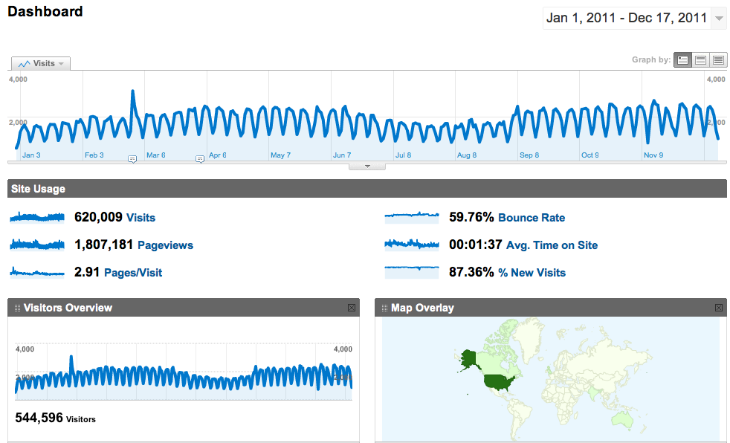
2011: IAN website visited by 544K unique visitors

Slide 4
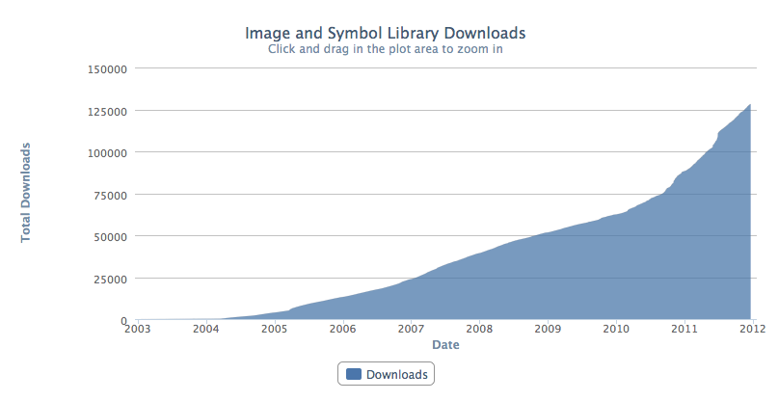
Image download rate dramatically increased in 2011

Slide 5
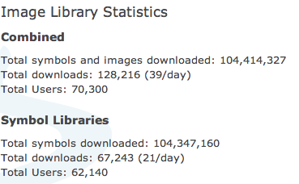
2011: IAN image library racks up some big numbers

Slide 6
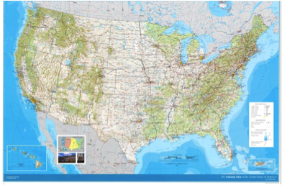
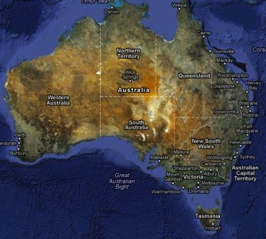
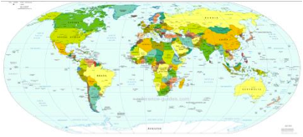
2011: IAN heads south

Slide 7
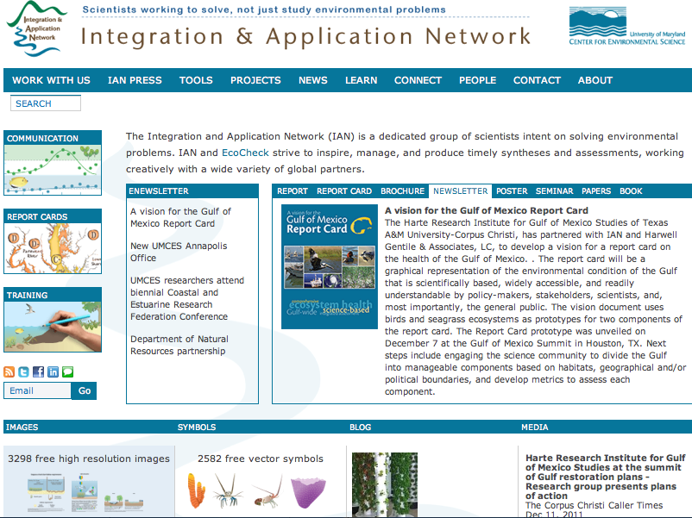
2011: IAN website has a makeover

Slide 8
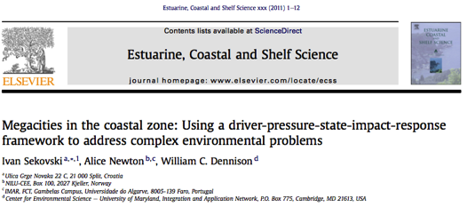
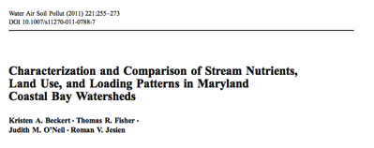
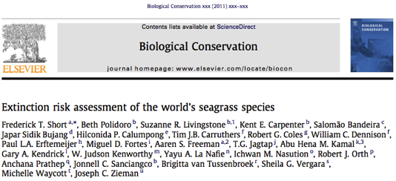
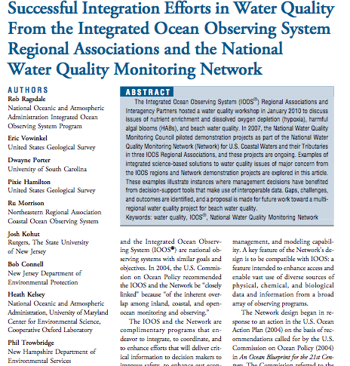
2011: IAN produces peer review papers

Slide 9
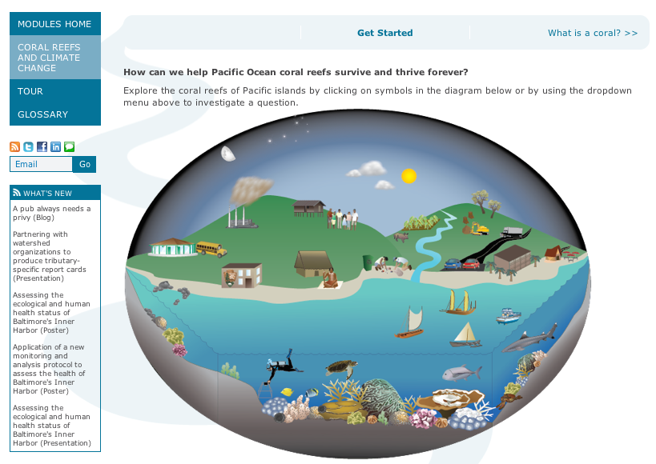
2011: IAN produces another education module

Slide 10
2011: Two globally iconic report cards launched

Slide 11
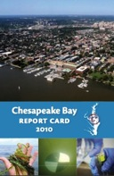
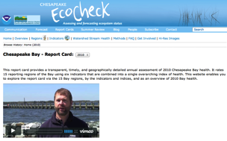
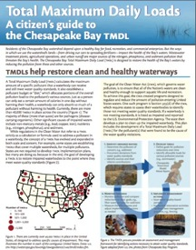
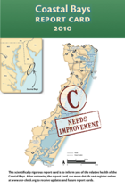
2011: IAN produces annual report cards + associated web site updates
Chesapeake Bay
Report card
+ >200 web pp.
Maryland Coastal Bays
Report card
+ >100 web pp.

Slide 12
IAN as an UMCES catalyst: SeSynC is up and running

Slide 13
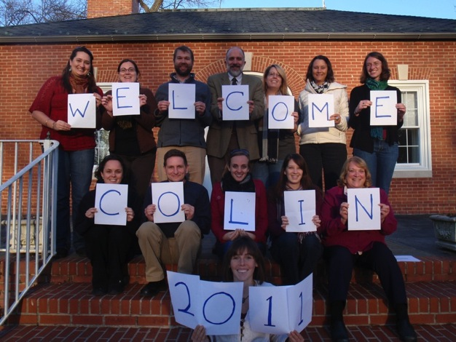
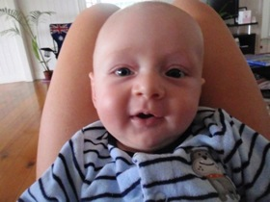
2011: IAN welcomes baby Colin Carruthers

Slide 14
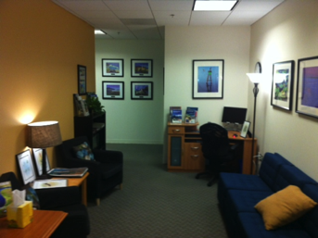
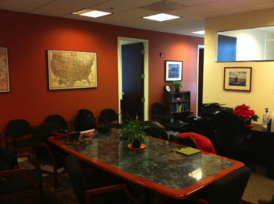
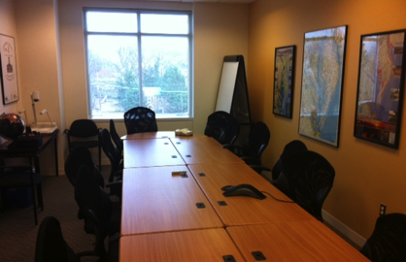
Classy new UMCES Annapolis Office

Slide 15
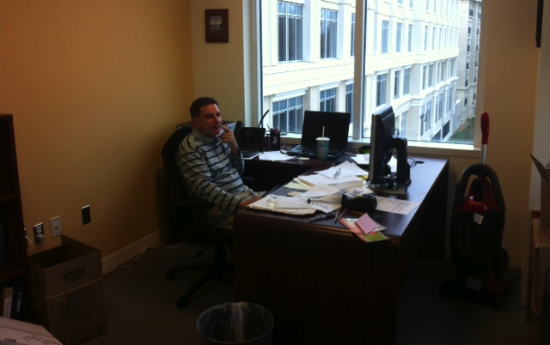
With a notable exception . . .

Slide 16
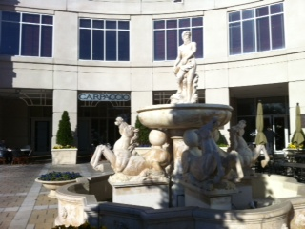
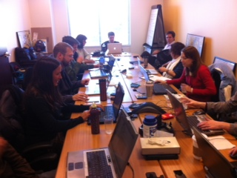
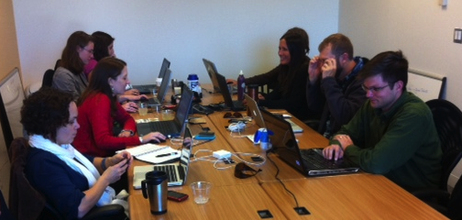
IAN moving into One Park Place

Slide 17
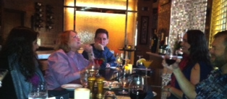
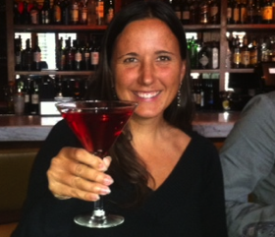
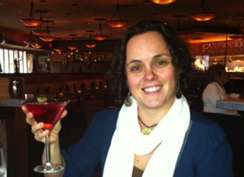
Bonus feature: One Park Place has happy hour

Slide 18
2011: New ‘UMCES @’ programs launched
UMCES @ DNR: Marcus & Jeff
EcoCheck (UMCES @ NOAA): funding via NCCOS
UMCES @ CBP: new grant & new people
One book published

Slide 19
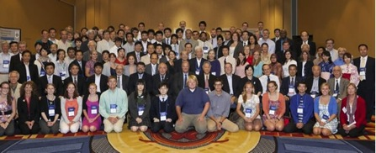
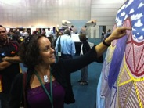
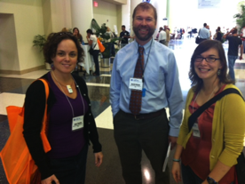
Major conferences in 2011
National Conference on Ecosystem Restoration (Baltimore)
Environmental Management of Enclosed Coastal Seas (Baltimore)
Riversymposium (Brisbane)
Coasts & Estuaries Research Federation (Daytona Beach)

Slide 20
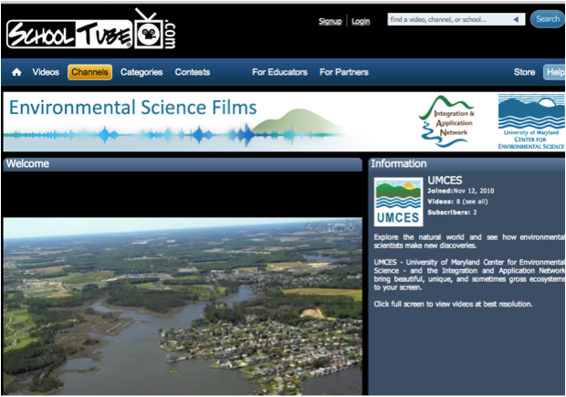
SchoolTube channel launched

Slide 21
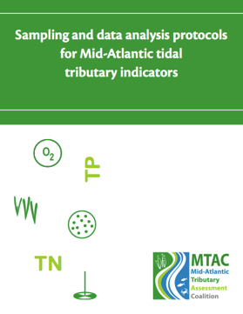
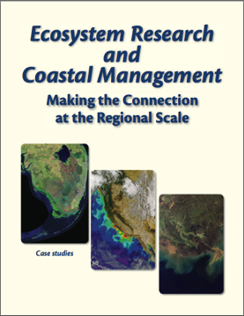
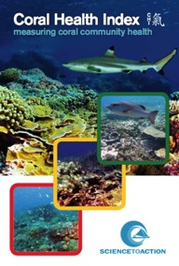
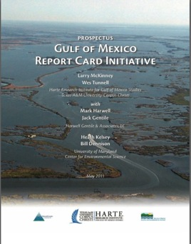
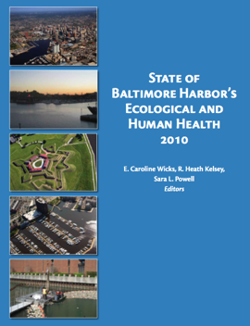
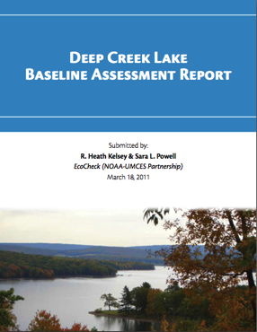
2011: 10 Booklets
Total = 519 pp.

Slide 22
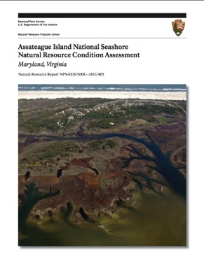
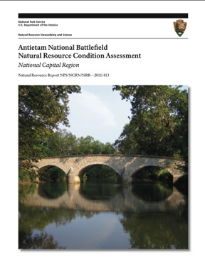
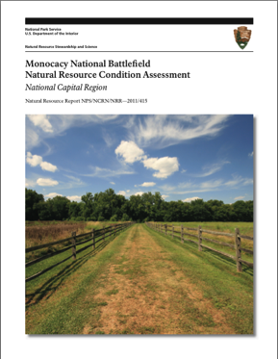
2011 National Park Service assessments: Assateague, Antietam, Manassas, & Monocacy
Total = 630 pp.

Slide 23
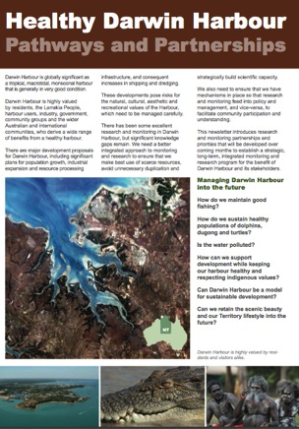
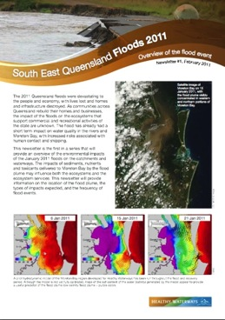
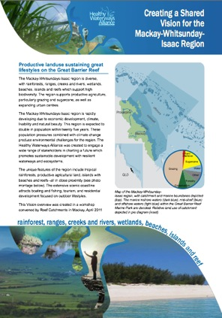
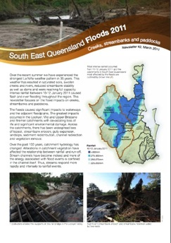
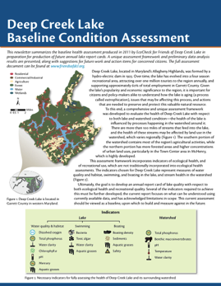
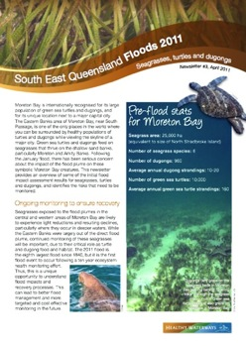
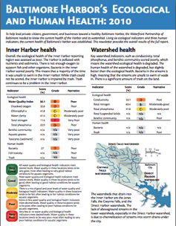
2011: Diverse newsletters produced

Slide 24
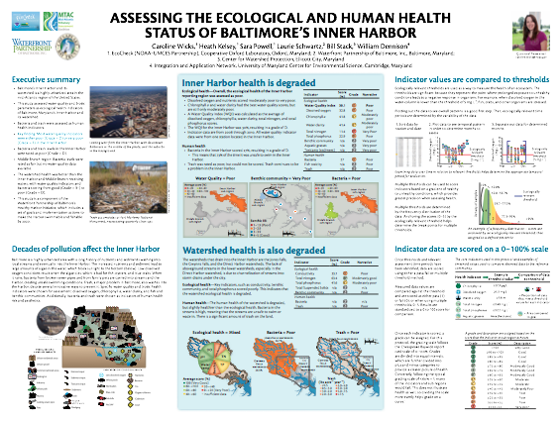
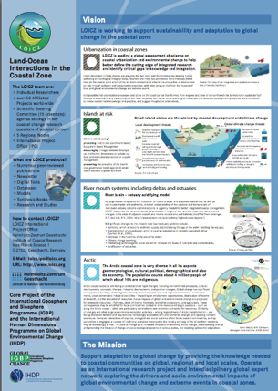
2011: IAN produces posters

Slide 25
Diagrams created in virtual collaboration

Slide 26
MTAC catalyzes regional report cards

Slide 27
2011: Lots of personnel transitions
New
Position
New
Person

Slide 28
Good-byes
Melissa
Joanna
Sara
Jeni
Jing
& baby

Slide 29
Goodbye to former IAN interns and Science Communicators
Allison
Kate

Slide 30
Timbo off to Samoa

Slide 31
Marbots (IAN ancestors) gather in Brisbane

Slide 32
2011: Bill was big in Australia

Slide 33
Simon & family arrive

Slide 34
Kate & Bill at University of Richmond

Slide 35
Bill and Jano hard at work at Darwin Harbour

Slide 36
2011: Captain Ken takes IAN for a sail

Slide 37
IAN produced banner = 1.5 Jano units

Slide 38
Developed an IAN marketing strategy

Slide 39
We considered a name change . . . but ended up staying with IAN:
Underpriced
Talented
Overworked
People
Into
Analyzing
Nature
Intelligent
Adept
Nerds

Slide 40
2011 IAN retreat

Slide 41
The IAN ‘tribe’

Slide 42
Steve Jobs & IAN principles
End to end production desired
Focus on high quality products
Intersection of art & technology
Only have A team members
Build things that WE want
People trying to change the world
The journey is the reward
Have heroes: people who have made a difference
Learn how the herd cats
Not everything works as planned; some things need to be dropped
Intuition, creativity & discipline needed
Tweak until it is clean

Slide 43
IAN history
IAN concept (2000) developed in UMCES faculty convocation; New position created (Vice President for Science Applications)
Initiation phase (2002-2004); Bill Dennison recruited from Univ. of Queensland, arrived in 2002 with Tim Carruthers, grants & contracts started, website launched
Partnership phase (2005-2007); EcoCheck created, Annapolis Synthesis Center created, bathhouse renovated, NPS partnership initiated
Accountability phase (2008-2010); IAN administration created (Program Manager--Tim Carruthers; Business Manager--Ken Barton; Administrative Specialist Dottie Samonisky), IAN Press launched, Image library launched, CI partnership initiated, environmental report cards

Slide 44
IAN future
Marketing phase (2011-) develop strong marketing web presence, expand partnerships and develop online revenue streams; expand report card locations, develop apps, choose a new logo

Slide 45
Jane Hawkey
1000 Ratings
Install
This app produces National Park Service science communication products at breakneck speeds while traveling extensively.

Slide 46
Simon Costanzo
1000 Ratings
Install
This techno geek app loves to buy expensive toys, play with them and convince everyone else that they too need the toys.

Slide 47
Heath Kelsey
1000 Ratings
Install
This app manages the IAN program, travels extensively, and produces report cards all over the world.

Slide 48
Jonathan Kellogg
1000 Ratings
Install
This app sets up data bases and collects monitoring data to develop various environmental report cards.

Slide 49
Tracey Saxby
1000 Ratings
Install
This app produces and maintains the Integration and Application Network symbol library with the intent of creating a global symbol language.

Slide 50
Caroline Wicks
1000 Ratings
Install
This app produces report cards, ecological forecasts and summer reviews for Chesapeake Bay and report cards in various other locations..

Slide 51
Kate Bentsen
1000 Ratings
Install
This app functions as director, producer, and editor of scientiific seminars for STAR and MTAC seminar series.

Slide 52
Jane Thomas
1000 Ratings
Install
This app is known as the Font Queen, as it evaluates different fonts for various science communication products.

Slide 53
Alex Fries
1000 Ratings
Install
This app functions as a ‘Jacqueline of all Trades’, producing videos, developing diagrams, editing books, and working on report cards both in Cambridge and Oxford.

Slide 54
Ken Barton
1000 Ratings
Install
This app keeps IAN solvent, makes sure that IAN staff are paid, orchestrates a office relocations and gets stuff done.

Slide 55
Danny Levey
1000 Ratings
Install
This inexpensive app serves as the office bitch, performing tasks that Science integrators and Science Communicators do not want to do.

Slide 56
Adrian Jones
1000 Ratings
Install
This app builds and modifies websites as fast as the entire IAN team can provide data, text and graphics in a scary sort of way.

Slide 57
Ashley Samonisky
1000 Ratings
Install
This helpful app provides support for financial accounting, as well as organizing facilities and relocation

Slide 58
Dottie Samonisky
1000 Ratings
Install
This app organizes the entire Integration and Application Network team, while providing the moral support in a way that only a mother can do.

Slide 59
Bill Dennison
1000 Ratings
Install
This app has no real function, and is very difficult to download and get working, often requiring copious amounts of espresso to get started.

