Slide 1
Care and Use of Vertebrate Animals
Dr. Janet Whaley
Veterinarian for UMCES
IACUC

Slide 2
My Info
Aquaculture Program Manager
USDA APHIS Veterinary Services
4700 River Road, Unit 46
Rm. 4B.02.11
Riverdale, MD 20737
Janet.E.Whaley@aphis.usda.gov

Slide 3
Vet Duties
UMCES Assurance of Compliance with the Public Health Service Policy on Humane Care and Use of Laboratory Animals -
advise on appropriate procedures for use of finfish in research, review research proposals, inspect UMCES facilities, and provide annual training.
authority to suspend any research found to be in violation of UMCES or PHS policy.

Slide 4
Justification
Research Goals
Non-animal alternatives
Duplication
Research species
Animal use and pain category

Slide 5
Pain and Fish
sensory receptors are present
central reception of sensory input is unclear
clinical signs of acute and chronic stress can be observed (↑cortisol levels, changes in other health and behavior parameters)
avoid adverse stimuli (reflex manner)

Slide 6
Pain Category
Category 1 little or momentary pain (euthanasia, tagging)
Category 2 potential pain or discomfort relieved by anesthetic (euthanasia, surgical procedure)
Category 3 discomfort or pain which is not relieved

Slide 7
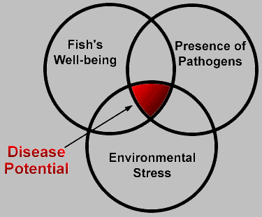
STRESS

Slide 8
Causes of Stress
water quality (O2, ammonia, nitrite, pH, other contaminants)
transportation
netting & handling
temperature
salinity
water hardness
poor nutrition
inappropriate housing conditions
noise
lighting
vibrations
stocking density

Slide 9
Stress Response
↑ Sympathetic nervous system activation
↑ cortisol
↑ catecholamines
↑ HR,↑ RR
↓ serum osmolality
↑ glucose
Immunosuppression
(↓ disease resistance)
↓ growth rate
↓ reproduction rate
delayed “capture” mortality

Slide 10
Experimental Procedures
Experimental design (include statistical methodology for data analysis and determination of number of animals to be used)
Methods and Materials (describe specifically any handling procedures)
Methods for anesthesia and euthanasia

Slide 11
Anesthesia
Consider for painful/stressful procedures and pre-euthanasia
Ice water (transport) - be careful
Chemical - MS-222, Benzocaine
Dose is species specific

Slide 12
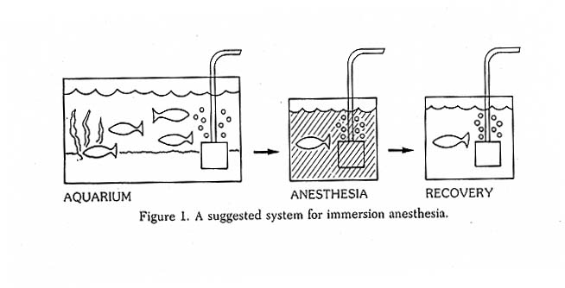
Immersion Anesthesia

Slide 13
MS-222
tricaine methanesulfate, ethyl-m-animobenzoate methansulfate, Finquel®
CNS depressant
water soluble but acidic (add buffer)
admin. via bath or recirculating system
for anesthesia 50-100 mg/L recommended (sedation vs surgical)
dose may be species specific - test before experiment

Slide 14
MS-222 con’t
induction w/in 3 minutes
recovery w/in 10-15 minutes after removal
is residual +/- could affect chemical analysis of tissue
no known hazards but wear gloves!
list as chemical hazard in UMCES application

Slide 15
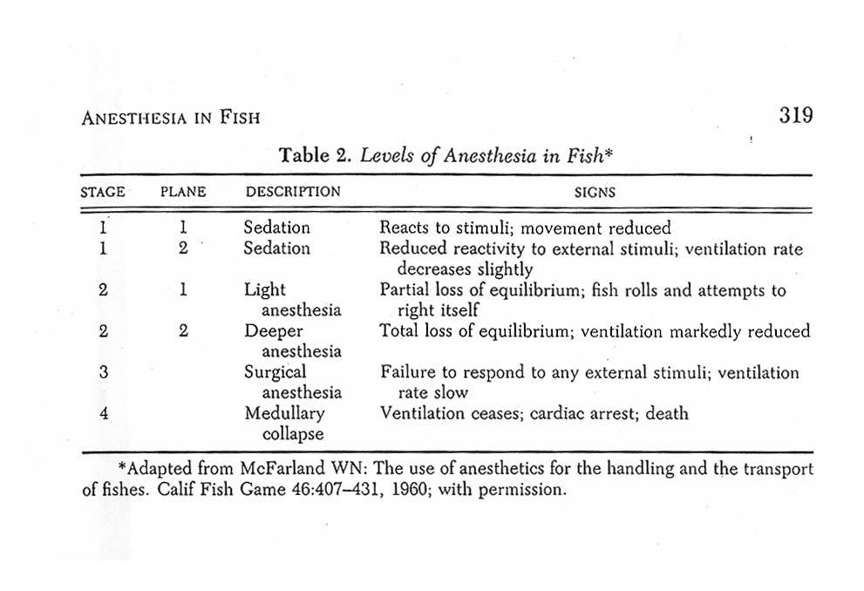
Levels of Anesthesia

Slide 16
Euthanasia
+/- pre-sedation with MS-222
decapitation
pithing
chemical (MS-222)
requires experience!!!
avoid direct insertion into fixative (alcohol or formalin)

Slide 17
Husbandry Practices
Briefly describe housing, feeding, etc. (refer to specific laboratory standard operating procedures)
Disposition of alive and dead animals

Slide 18
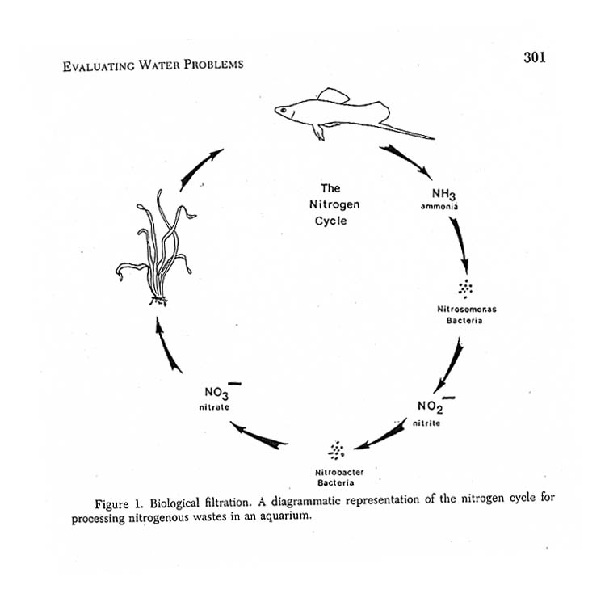
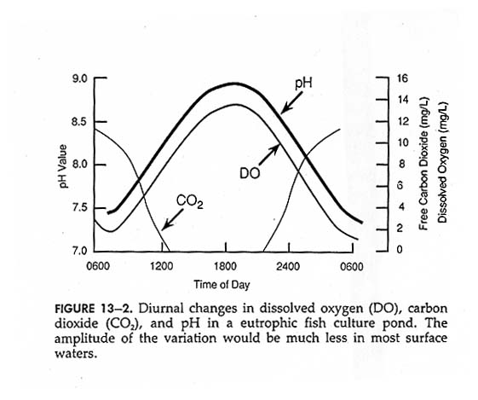
Water Quality

Slide 19
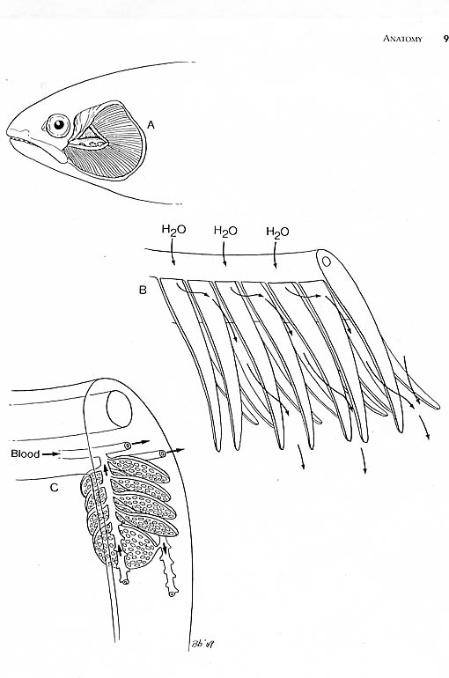
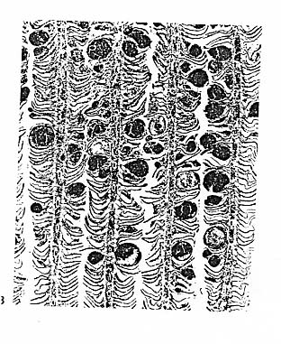
The Importance of
Good Water Quality

Slide 20
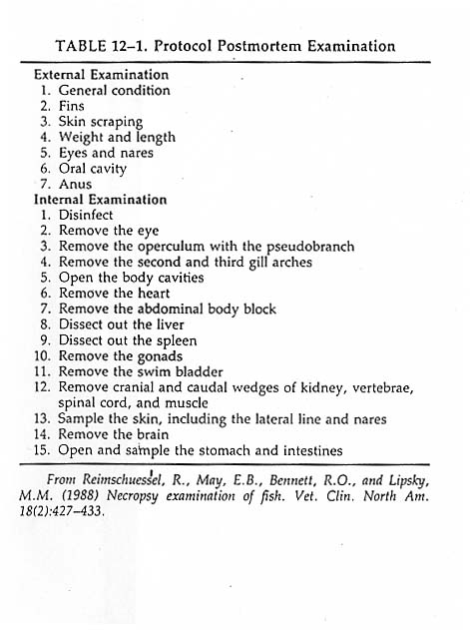
Investigate mortality in your system
Basic necropsy
Know your species
Seek advice
Make appropriate changes

Slide 21
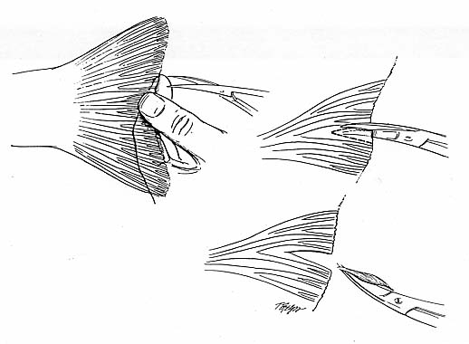
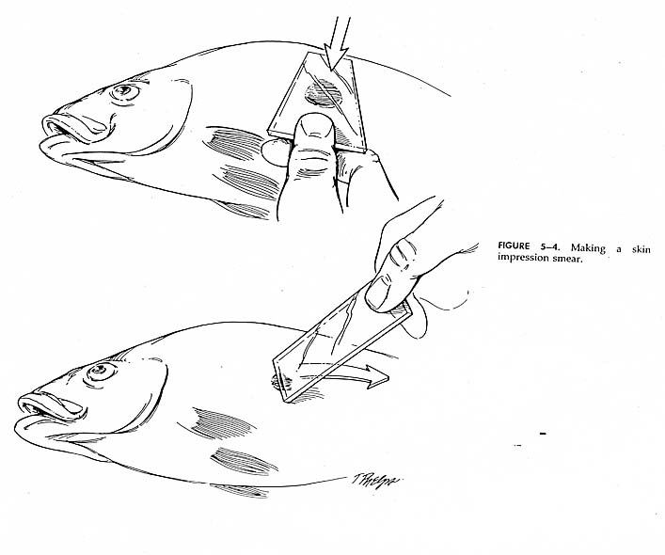
Simple Diagnostics
Skin scrape
Fin clip

Slide 22
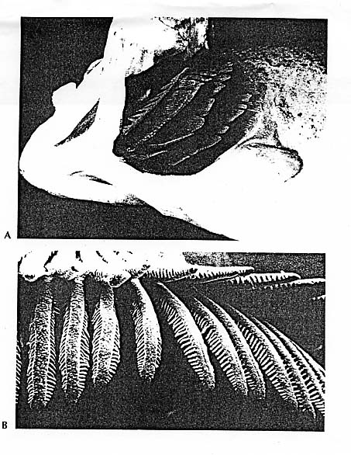
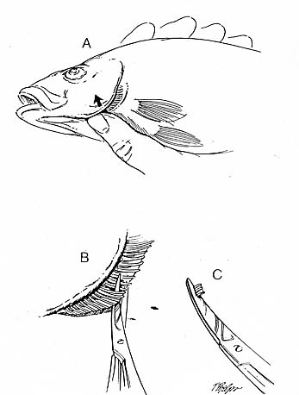
Simple Diagnostics
Gill clip

Slide 23
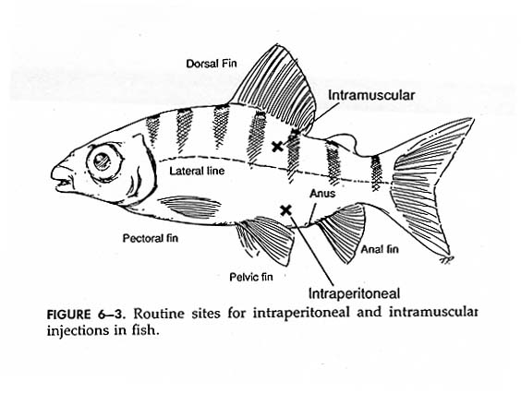
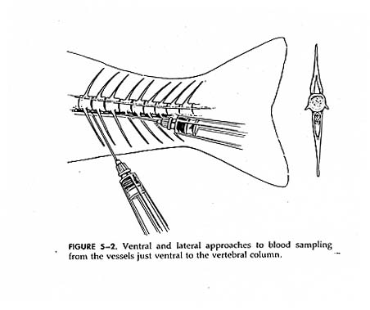
Clinical Diagnostics
Blood collection for analysis

Slide 24
Environmental Safety
infectious agents
chemical hazards (include MS-222)
radioisotopes
biohazards

Slide 25
ZOONOSIS
Zoonosis = disease that can be transmitted from animals to humans (or other animals)
Anthroponosis = disease that can be transmitted from humans to animals
High Risk
      immunosupressed (AIDs, other debilitating disease)
      pregnant
      age
Exposure (infected water, fish tissue, fish excrement)
      dermal contact via skin abrasion, fissure
      ingestion

Slide 26
Zoonotic Diseases
Potential for disease organisms to spread between species (fish ↔ human)
Bacteria - from handling (mycobacterium, streptococcus, erysipelothrix, vibrio, norcardia, aeromonas, edwardsiella)
from ingestion (stahylcoccus, clostridium, vibrio, aeromonas, esherichia, salmonella,
edwardsiella)
Parasites - primarily from ingestion (nematodes, cestodes, trematodes, protozoa).
Toxins - primarily from ingestion (ciguatera, scombroid, dinoflagellates toxins)

Slide 28
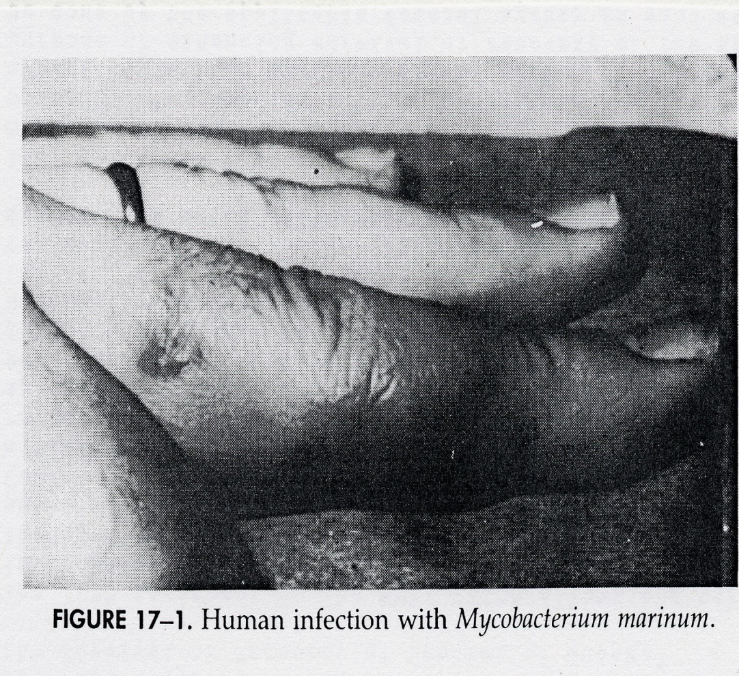
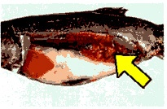
Mycobacteria

Slide 29
PREVENTION
Fish
    Know health of your fish
    Proper husbandry/aquaculture
    Minimum - wear gloves when handling
All Wildlife
    Know the hazards
    Take all necessary “known”precautions
    DO YOUR HOMEWORK!!!

Slide 30
References
Can Fish Suffer?: perspectives on sentience, pain, fear and stress; K.P. Chandroo et al./Applied Animal Behaviour Science 86 (2004) 225-250
Fish Cognition and Behavior; Culum Brown et al.; Blackwell Publishing (2006) ISBN: 9781405134293
Fish Medicine; Michael Stoskopf, W.B. Saunders Company; 1st edition (January 15, 1993) ISBN: 0721626297

