Slide 1

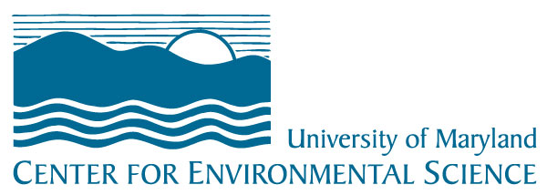

category goes here and here

Slide 2
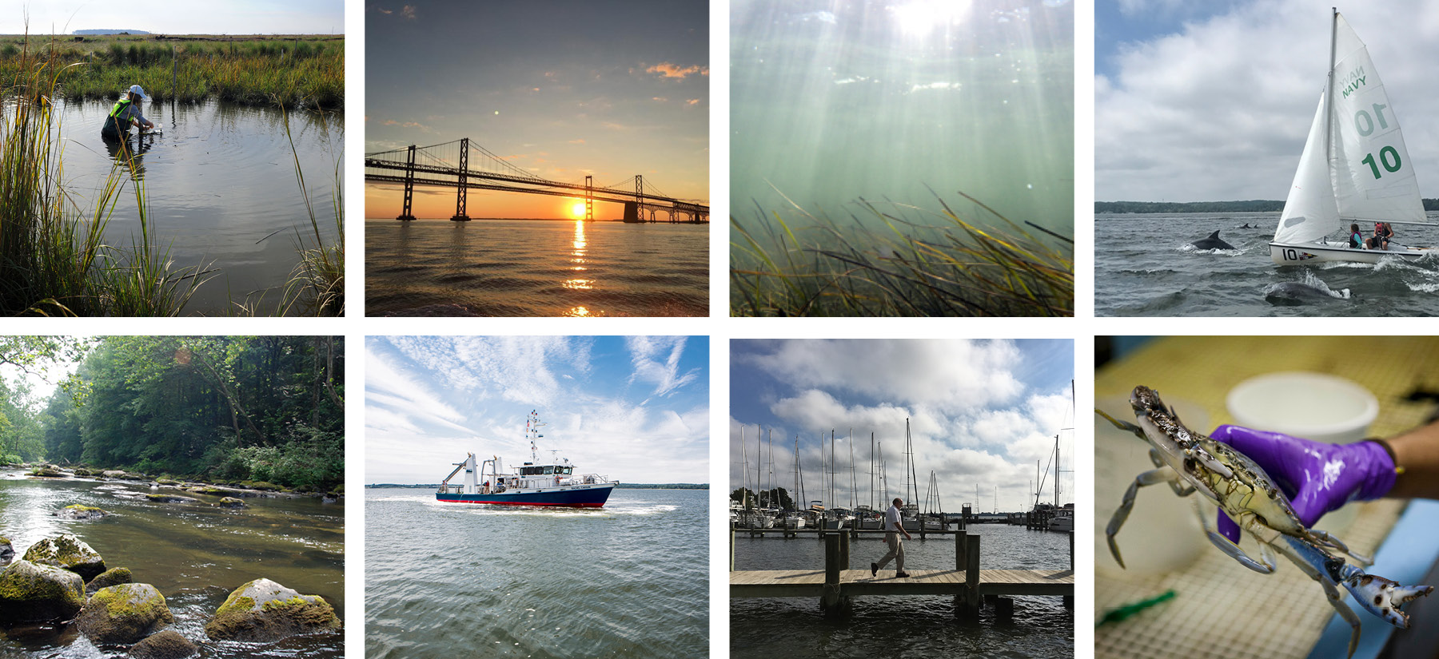
category goes here and here
The University of Maryland Center for Environmental Science is a globally eminent research and graduate institution focused on advancing scientific knowledge of the environment.

Slide 3
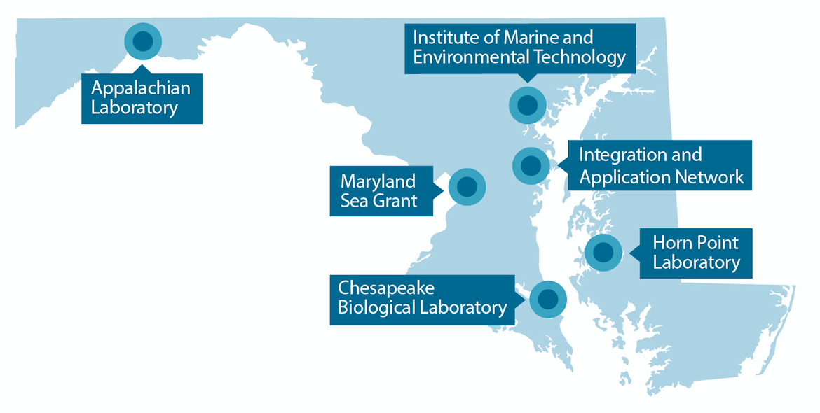

category goes here and here
Campuses located from the mountains and the sea provide direct access to Maryland’s diverse natural ecosystems, allowing us to be a world leader in the science of coastal environments and their watersheds
.
.
MISSION:
A unique statutory mandate to conduct a comprehensive scientific program to develop and apply predictive ecology for the improvement and preservation of Maryland’s physical environment.

Slide 4
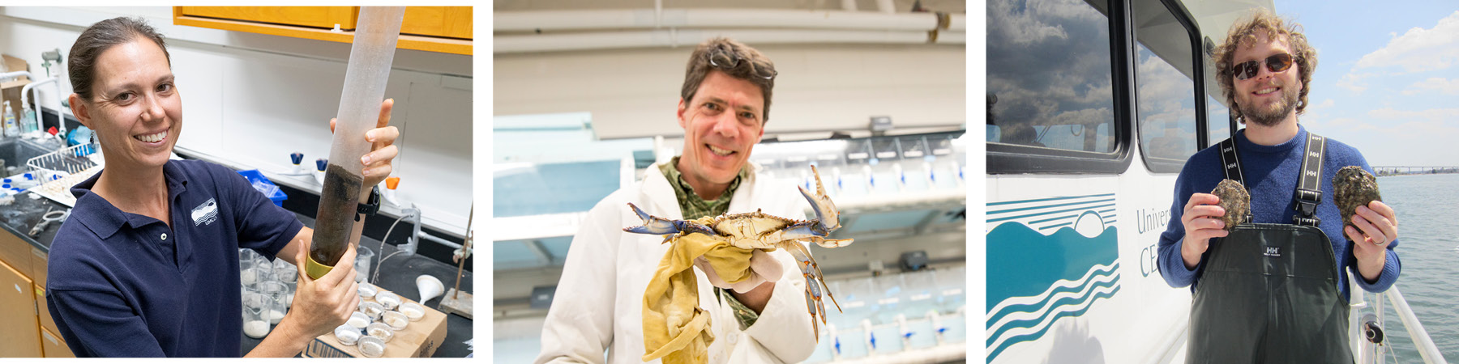
category goes here and here
RESEARCH
Our scientists work across disciplines and in diverse settings—from the Appalachian Mountains to the Arctic, from fisheries to climate change—to understand and discover solutions to challenges in the Chesapeake Bay and around the world.

Slide 5
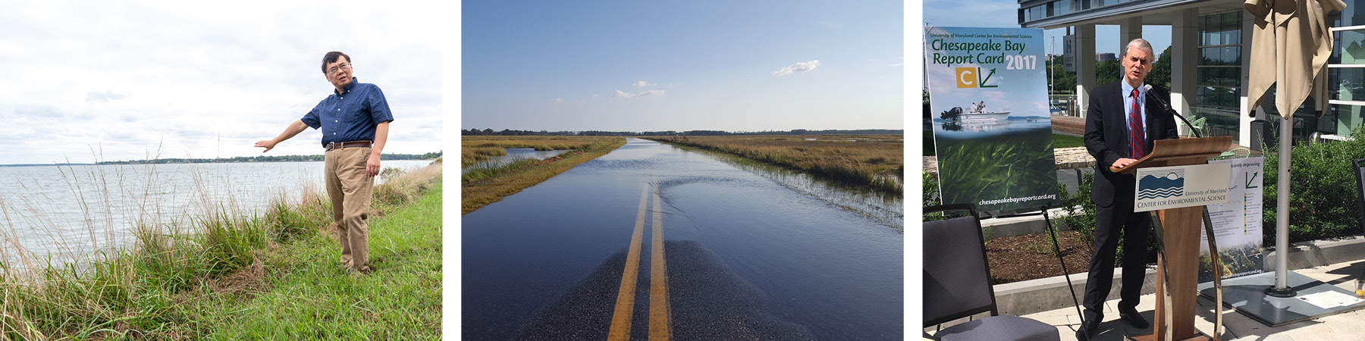
category goes here and here
PUBLIC SERVICE
As a trusted advisor to state and national leaders, we provide the scientific basis for policymakers and civic leaders to address pressing environmental issues in our communities and around the globe, from sustaining healthy crab and oyster fisheries to protecting coastal communities from sea-level rise.

Slide 6
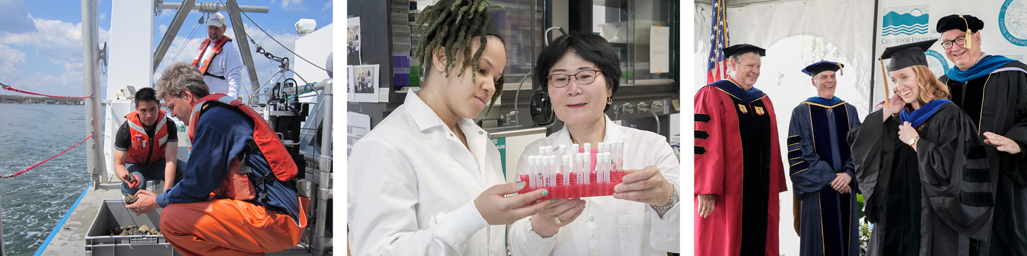
category goes here and here
GRADUATE EDUCATION
We train and inspire the nation’s next generation of environmental leaders as part of the University System of Maryland’s nationally ranked graduate program in marine and estuarine science. Graduates conduct research at major universities, manage natural resources in public agencies, and drive entrepreneurial innovation in the private sector.

