Slide 1
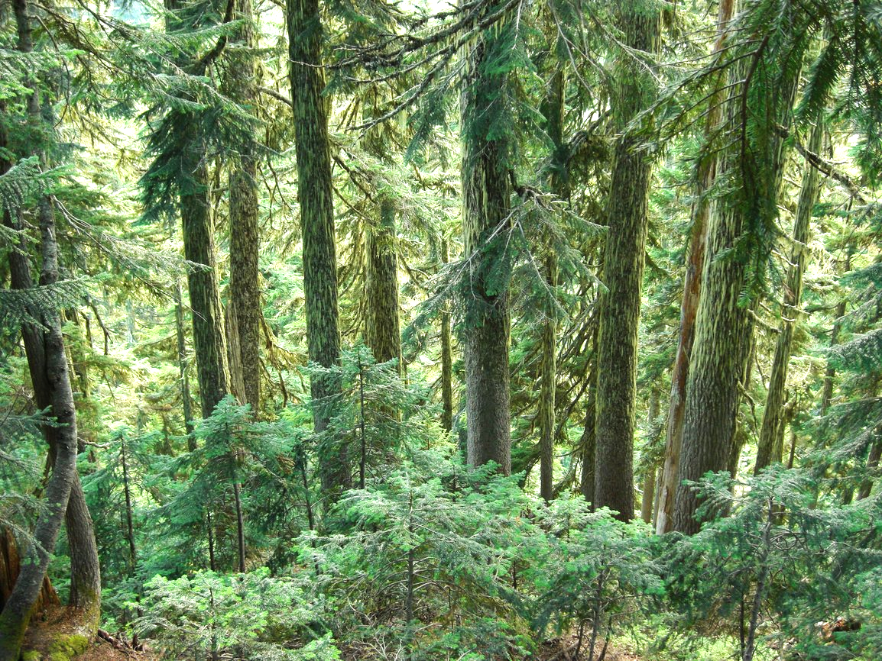
Integrated Pest Management for Eastern Hardwood Forests at Swallow Falls State Park
Aubrey Tingler
Megan Massa
MEES 718I
Notes:
Do what you want here, just trying to get a title slide going

Slide 2
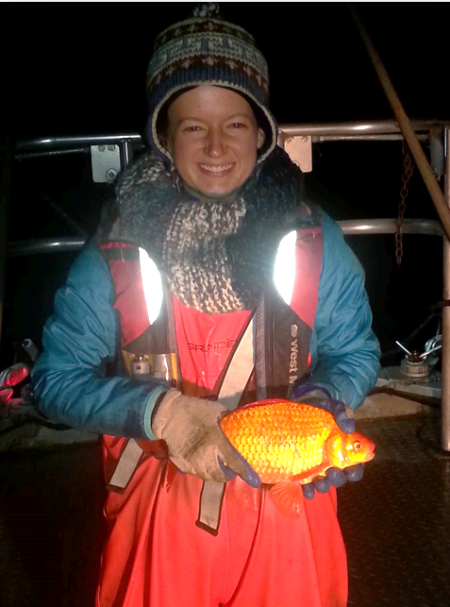
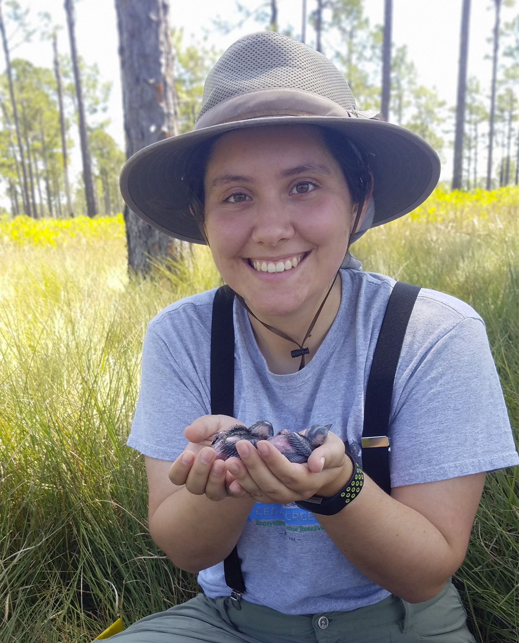
Aubrey Tingler (she/her)
MEES MS Student (2022)
Environment and Society Concentration
UMD College Park Campus
Megan Massa (she/her)
MS Student (2022)
Applied Ecology & Conservation Biology
UMCES Appalachian Lab
Invasive goldfish
Non-invasive woodpeckers
With thanks to Craig Kuhn and Biff Thompson from the Maryland Department of Agriculture

Slide 3
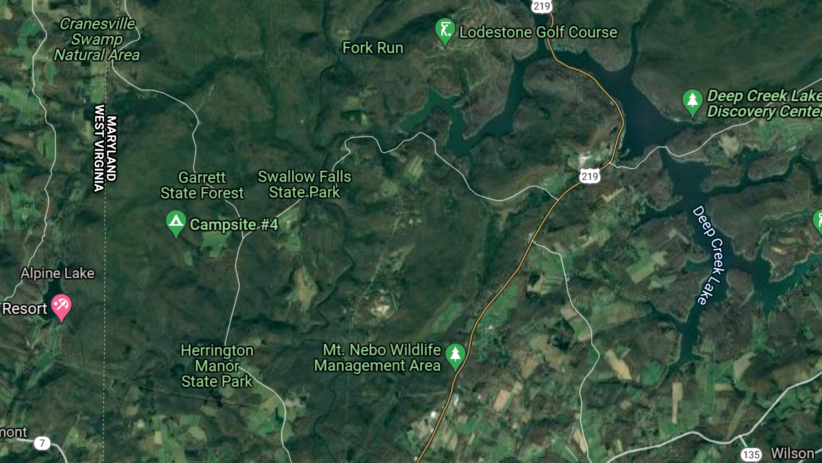
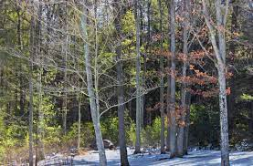
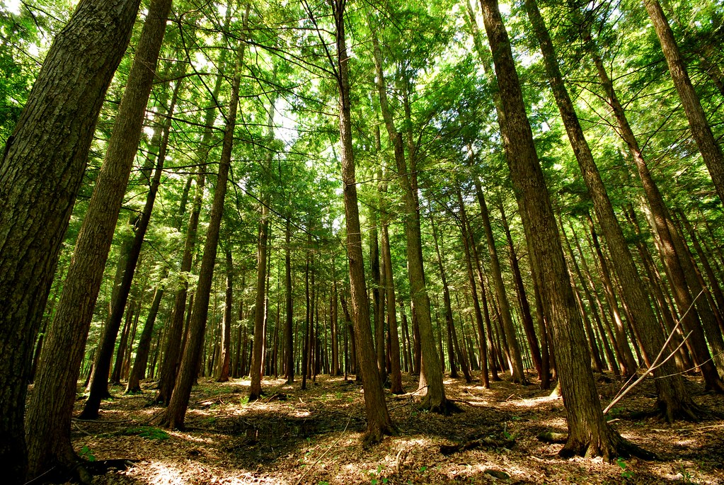
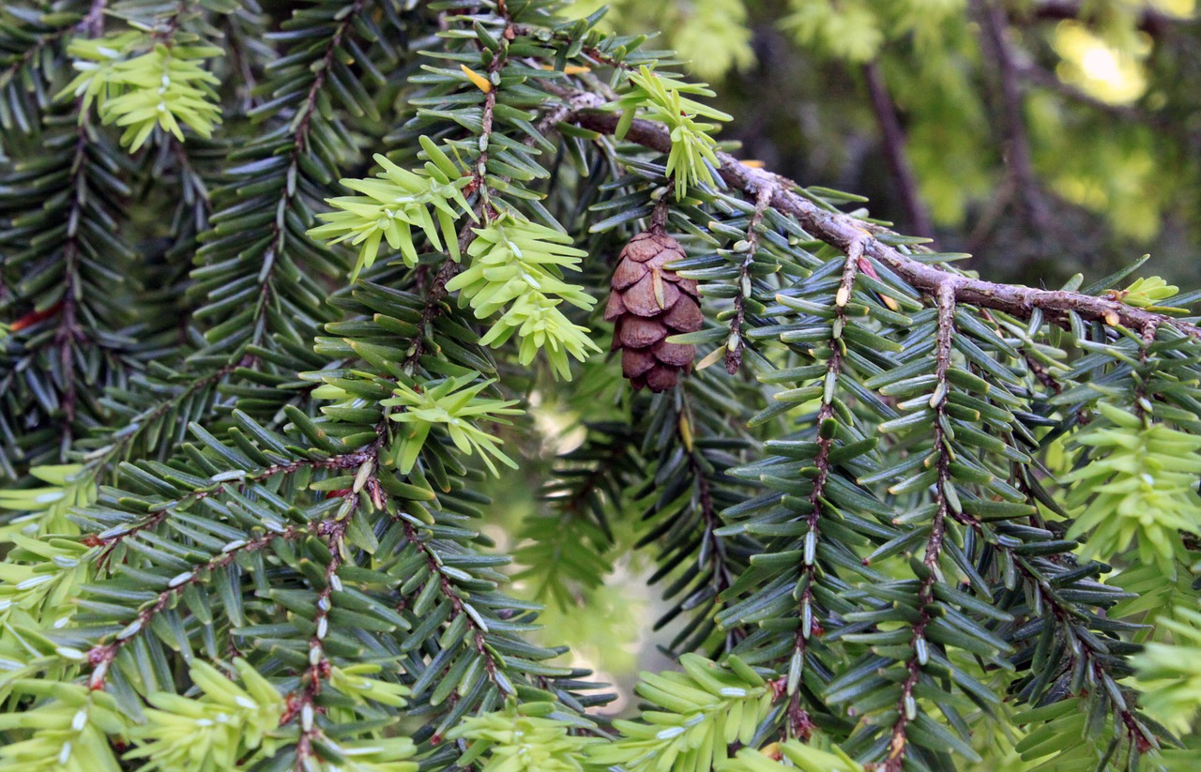
Northern hardwood forests
Swallow Falls State Park
Notes:
We covered northern hardwood forests. Much of Maryland, especially western Maryland, is part of this ecosystem. We chose Swallow Falls State Park as an example because its mixed hardwood forest with large riparian areas compared to its size
Which species make up the ecosystem?
What services does the rich biodiversity here provide?

Slide 4

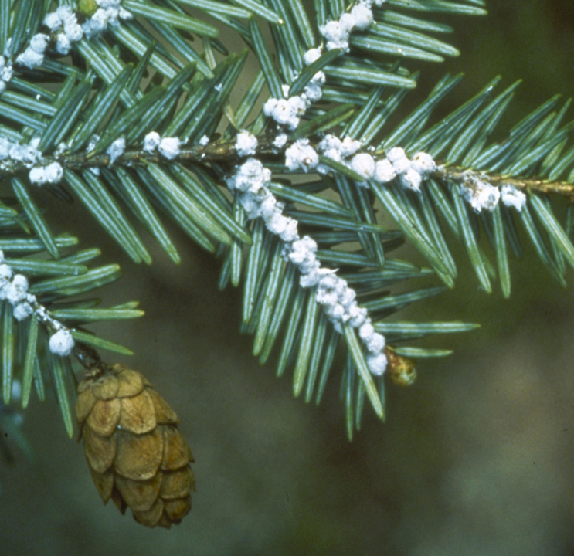
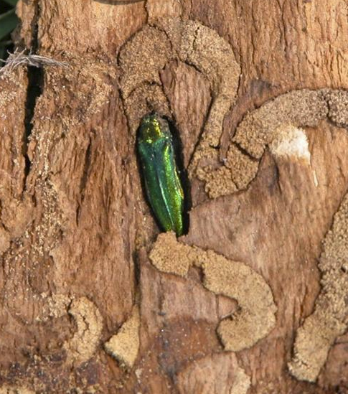
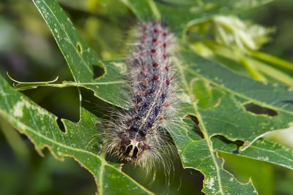
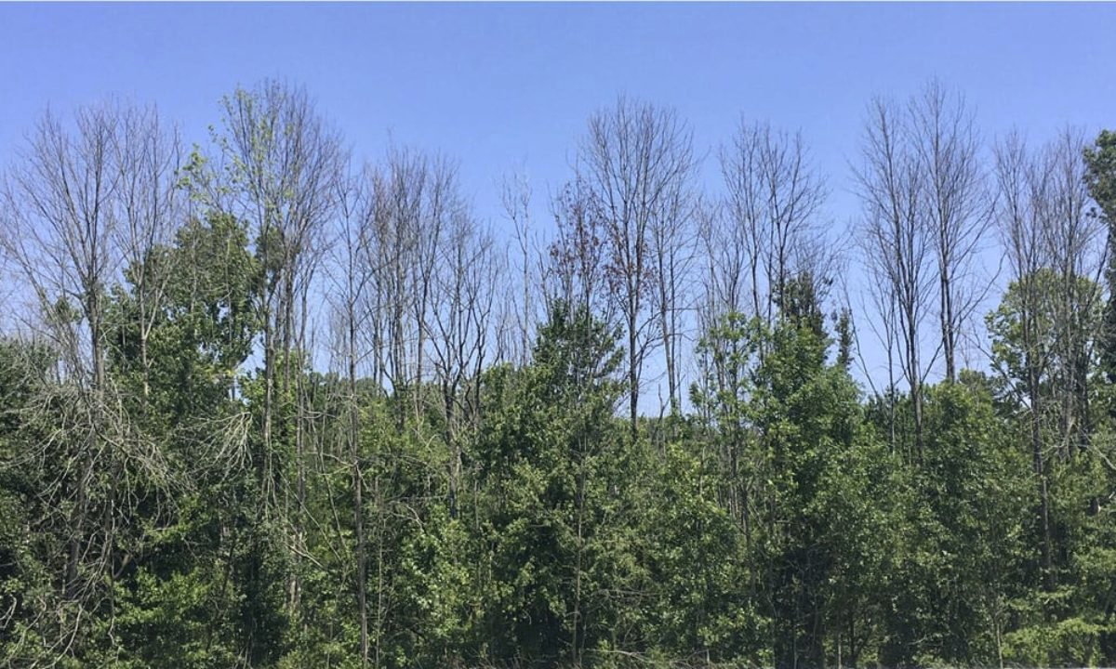
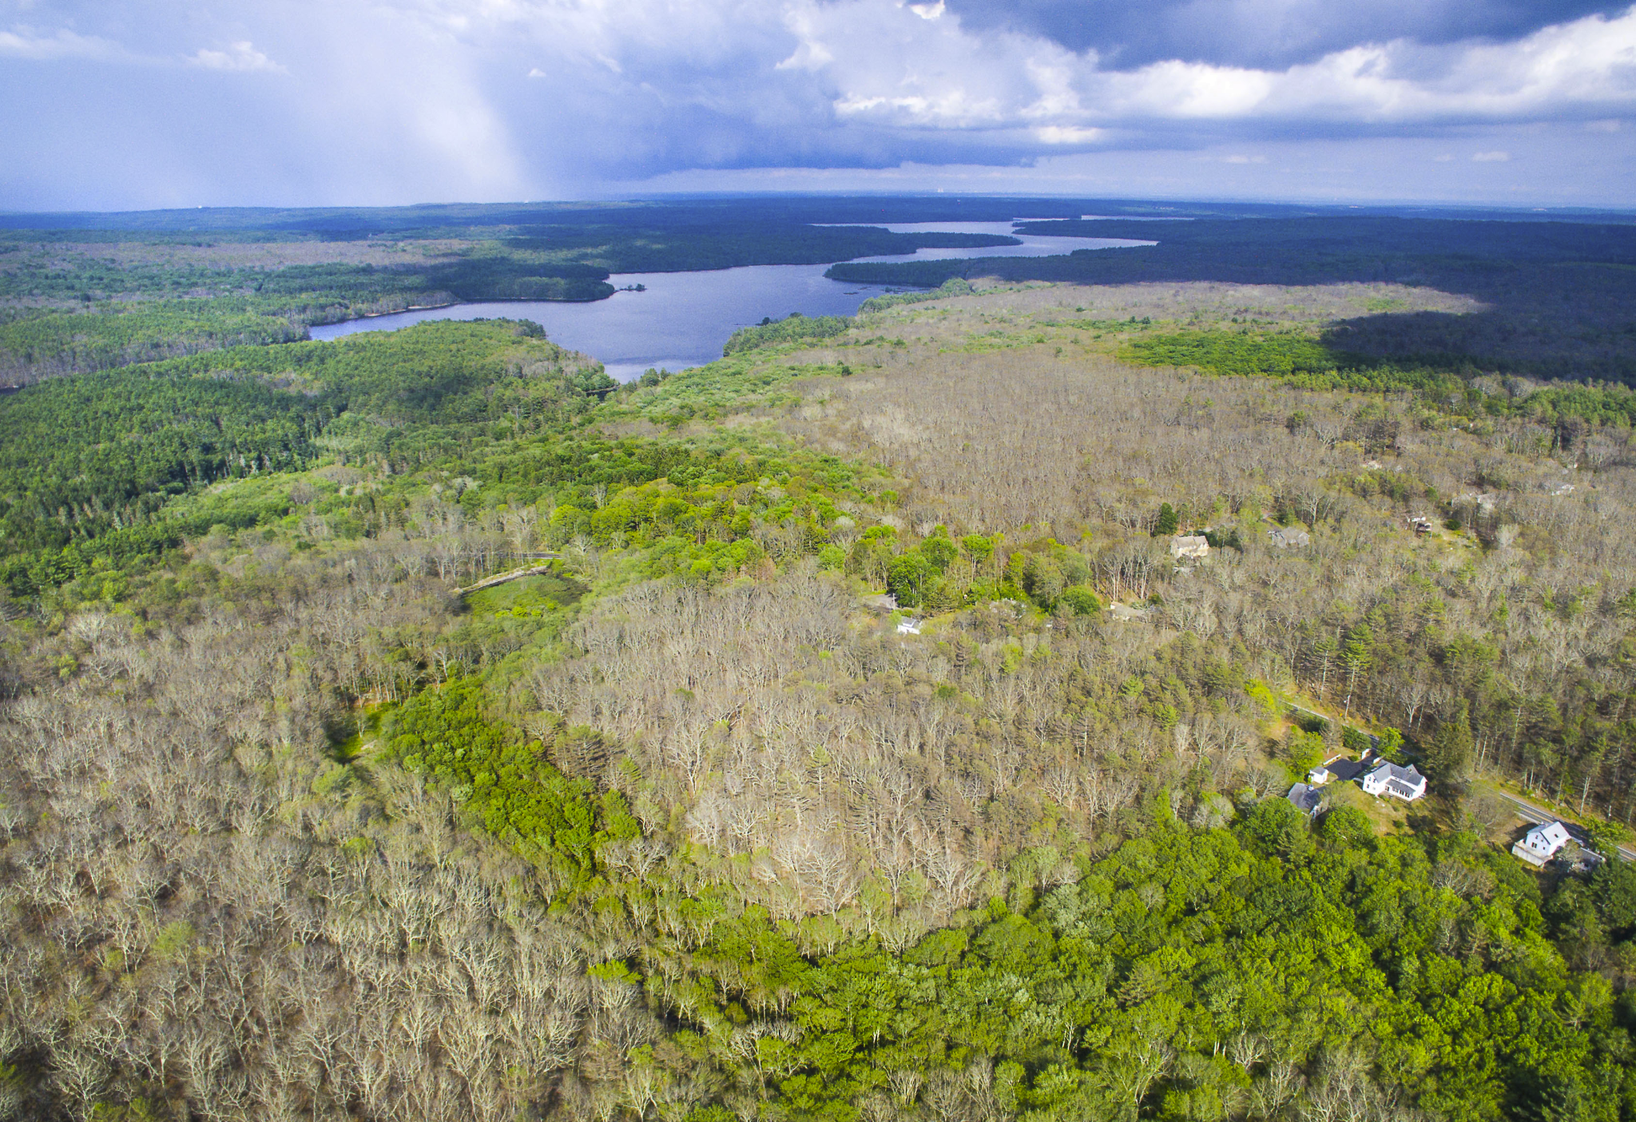
Major invasive species & impacted relevant species of concern
Connecticut Agricultural Experiment Station
Virginia Cooperative Extension
AP Photo/Mel Evans
Biltmore Beacon
Beaver Tree Service
Boston Globe
Hemlock woolly adelgid (HWA)
Adelges tsugae
↓
Eastern hemlock
Tsuga canadensis
Emerald ash borer (EAB)
Agrilus planipennus
↓
Ash trees
Fraxinus spp.
Lymantria dispar
↓
Various hardwoods
Notes:
These hardwood forests are threatened by several invasive pest insects that are capable of killing trees.
The hemlock woolly adelgid HWA is a Hemipteran or true bug that was likely introduced via ornamental plantings of Japanese hemlock. HWA has been detected in every county in Maryland.
The emerald ash borer EAB is an Asian beetle that was likely introduced in the 1990s and spread through lumber and firewood. It arrived in Maryland in 2003.
Lymantria dispar, whose common name was recently retracted, is an invasive European moth that has been in the US since the 1860s. It is a generalist that can defoliate over 300 different species of trees and shrubs.
[Click] Together these three species do millions of dollars of damage, threaten the tree species they feed on, and threaten the integrity of hardwood forest ecosystems. At Swallow Falls, hemlocks in particular are a species of concern as there is an old-growth grove there, but ash and other hardwoods are present too.

Slide 5
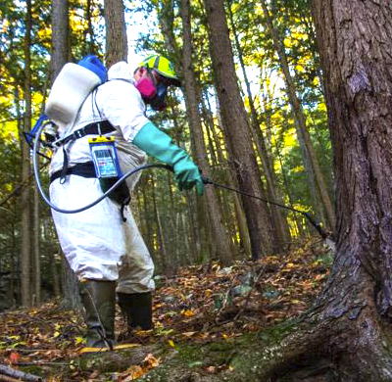
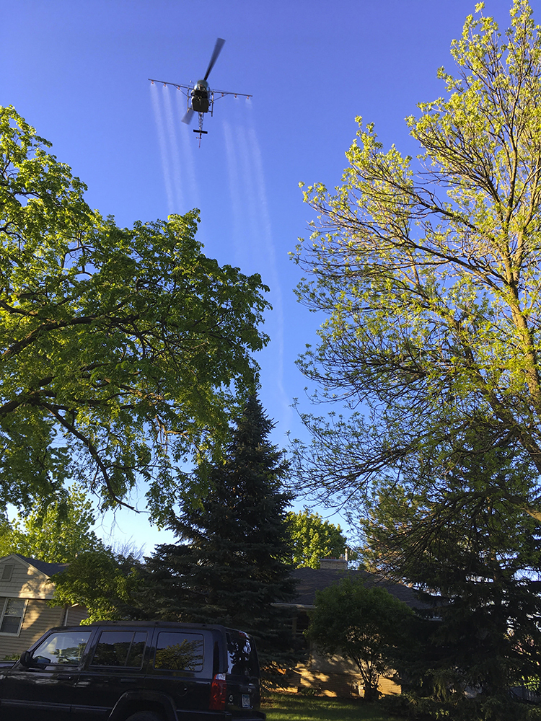
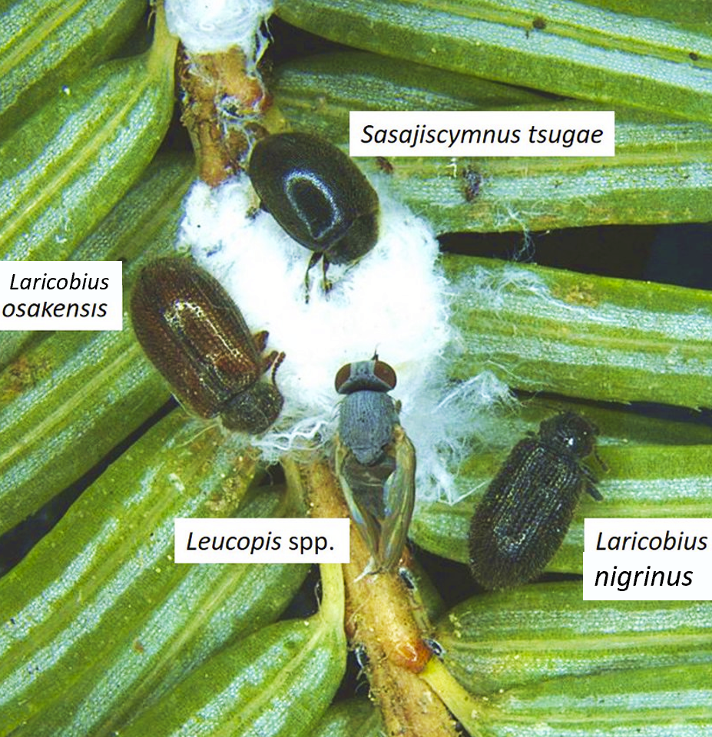
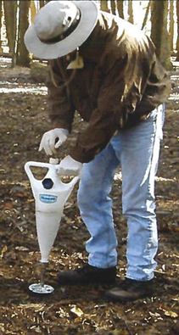
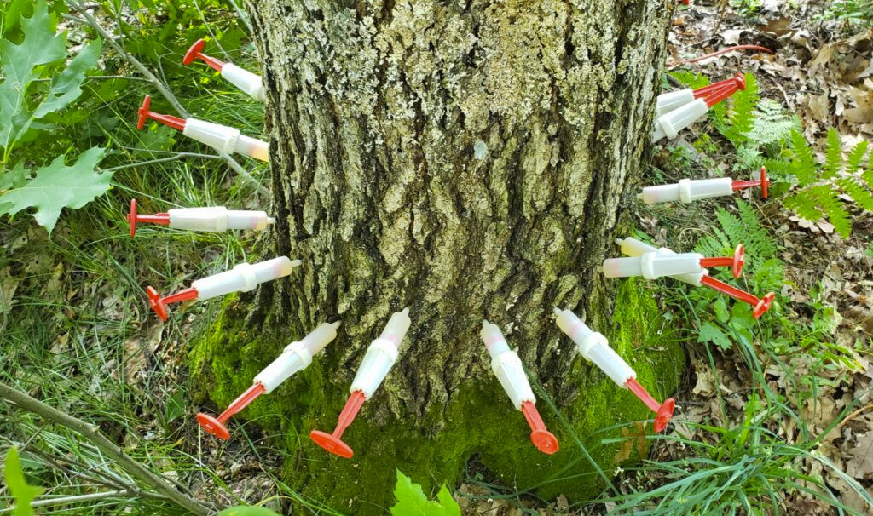
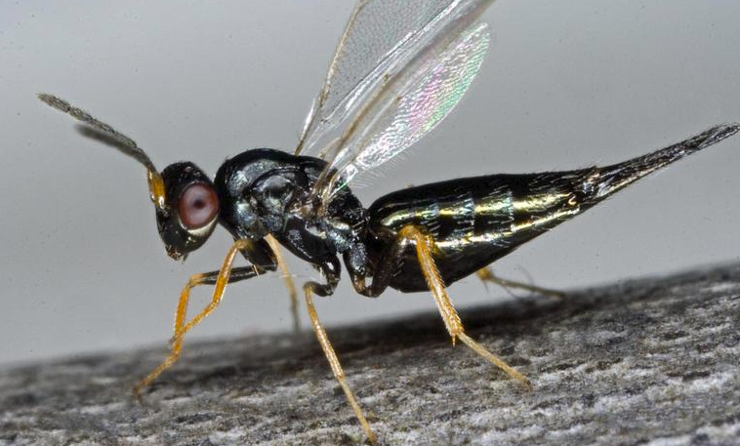
Management approaches
Entomology Today
Adirondack Daily Enterprise
Elizabeth Benton, UGA
Tetrastichus planipennisi
ChemJet
USDA
David Cappaert / CC-BY-NC 3.0
Notes:
But there is some good news: management strategies exist for insect pests and have preserved many trees.
HWA and EAB are both treated with neonicotinoid insecticides, primarily imidacloprid and dinotefuran.
These are applied through soil drench, trunk injection, and soil injection.
L. dispar can be treated with aerial spraying of a bacterial insecticide called Btk.
There are also options to manage with biocontrol, such as various beetles and a silver fly to control HWA, and parasitoid wasps to control EAB.
In Swallow Falls State Park, hemlocks are currently only treated with insecticide as biocontrol has not yet been established.
The solution can also be its own problem, however.

Slide 6
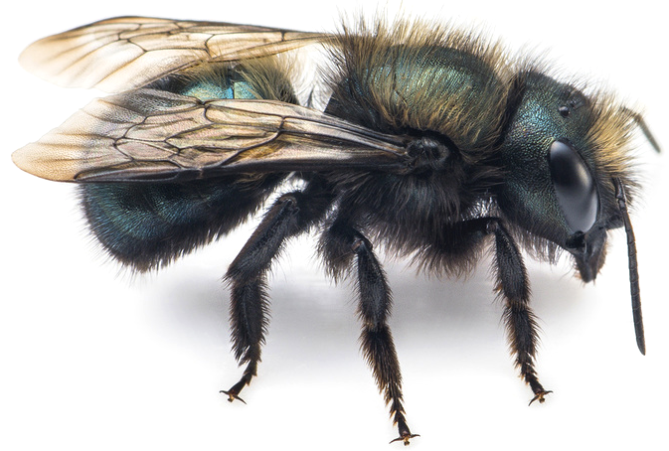
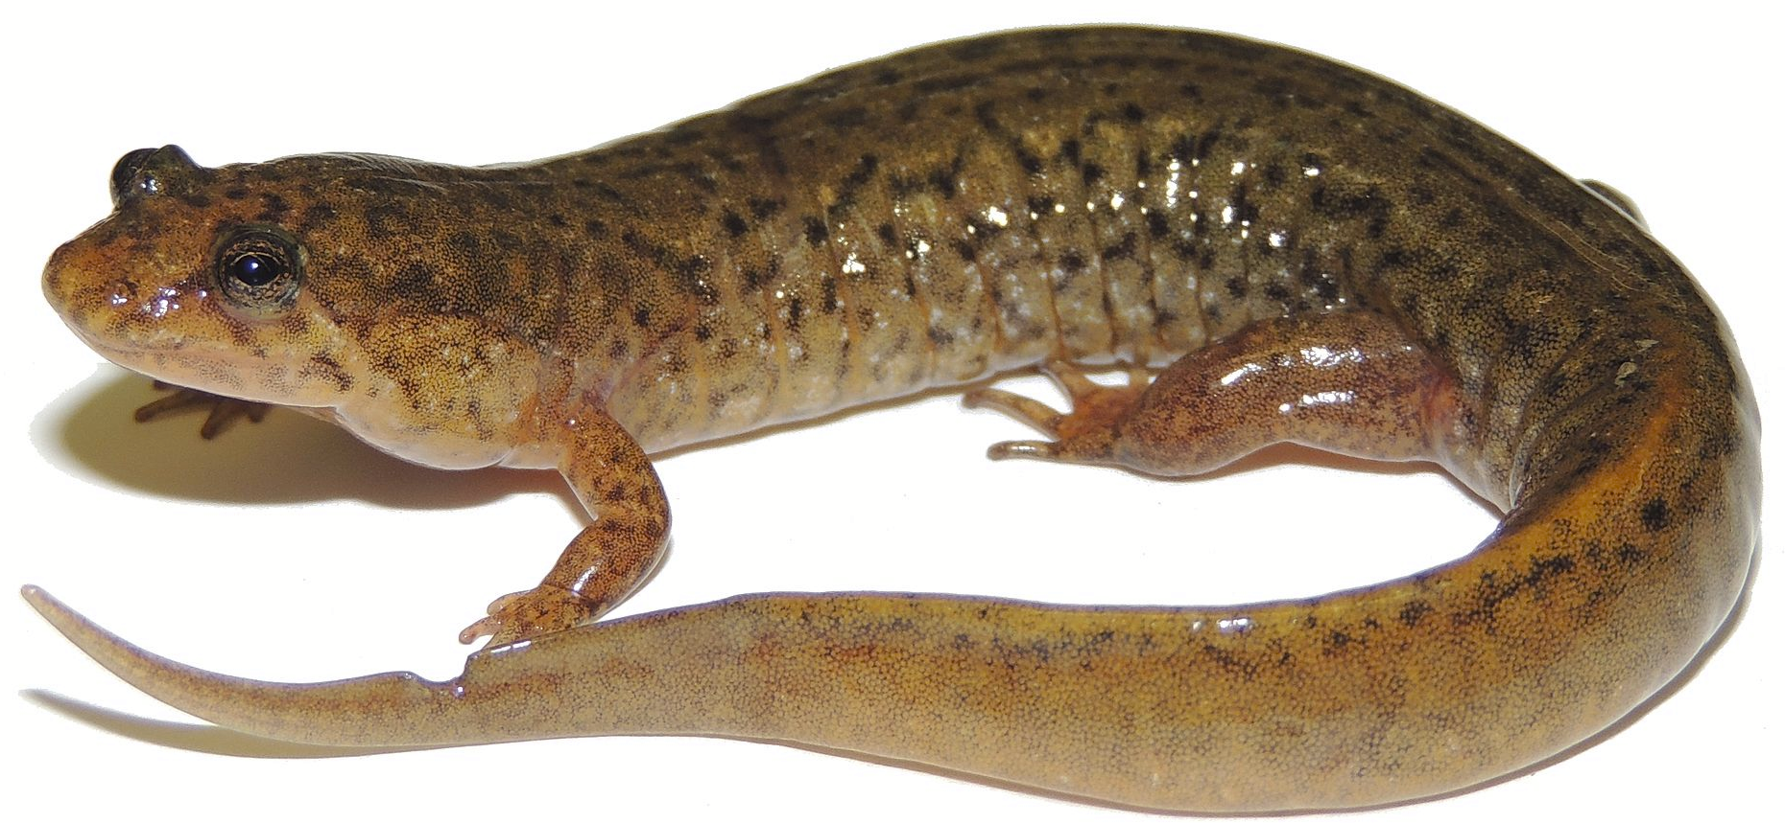
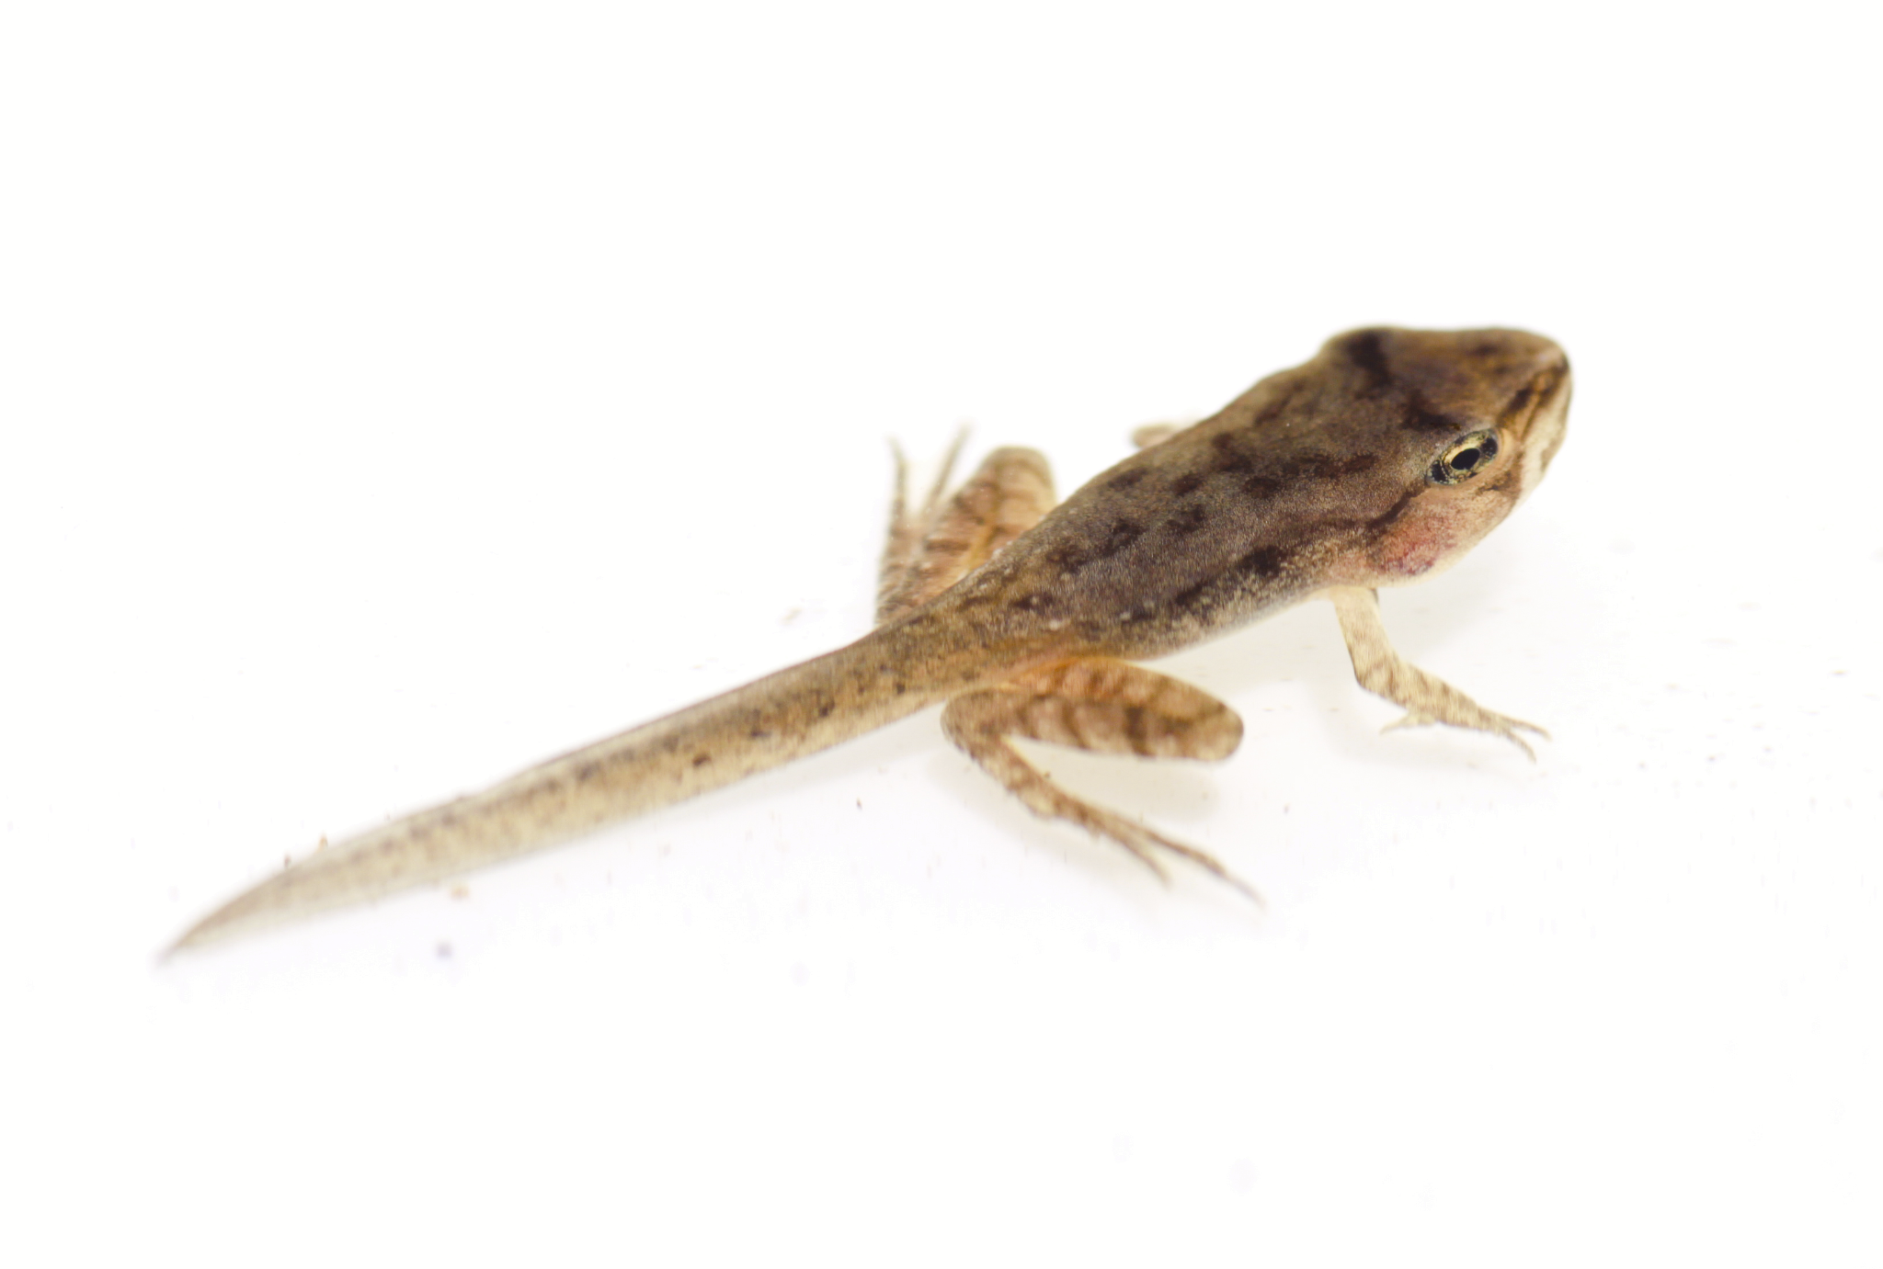
Management challenges: Unintended consequences
Imidacloprid runoff detected in streams near HWA treatment (Benton et al. 2016)
Non-target impacts:
- Death of ground-nesting bees (Fortuin et al. 2021)
- Bioaccumulation of neonics in many amphibians with sublethal effects (Crayton et al. 2020, Sweeney et al. 2021)
- L. dispar spray kills any lepidopteran caterpillar
Thomas Shahan
Brian Gratwicke / CC-BY 2.0
Hargle / CC-BY-SA 3.0
Notes:
One of the greatest challenges in using insecticides is managing the unintended consequences for native flora.
“We don’t want to harm the biodiversity we seek to protect”

Slide 7
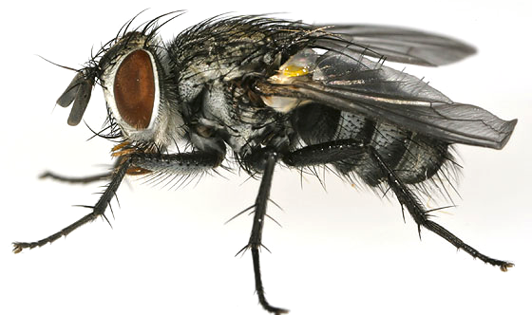
Management challenges: Unintended consequences
Caution with biocontrol
HWA:
  Hybridization of Laricobius nigrinus with native Laricobius rubidus (Mayfield et al. 2015)
L. dispar:
  Introduced parasitic fly also targets natives, including Luna moth and Cecropia silk moth
oops!
Joyce Gross, BugGuide.net
Notes:
HWA: Fears of widespread hybridization haven’t come to fruition but it is happening in small numbers and we don’t yet know what potential consequences might be.
L dispar has a long history of biocontrol attempts, including one that went very badly: the parasitic fly Compsilura concinnata is a generalist not synchronized with the breeding cycle of L dispar, and it has harmed native moths including Luna moth and silk moths. In recent years the Focus has switched to bacterial, fungal, and viral treatments and more specialized parasitoids.
OUR SYNTHESIS FOCUSED ON technical strategies to mitigate these unintended consequences and how to move toward an integrated approach for pest management.

Slide 8
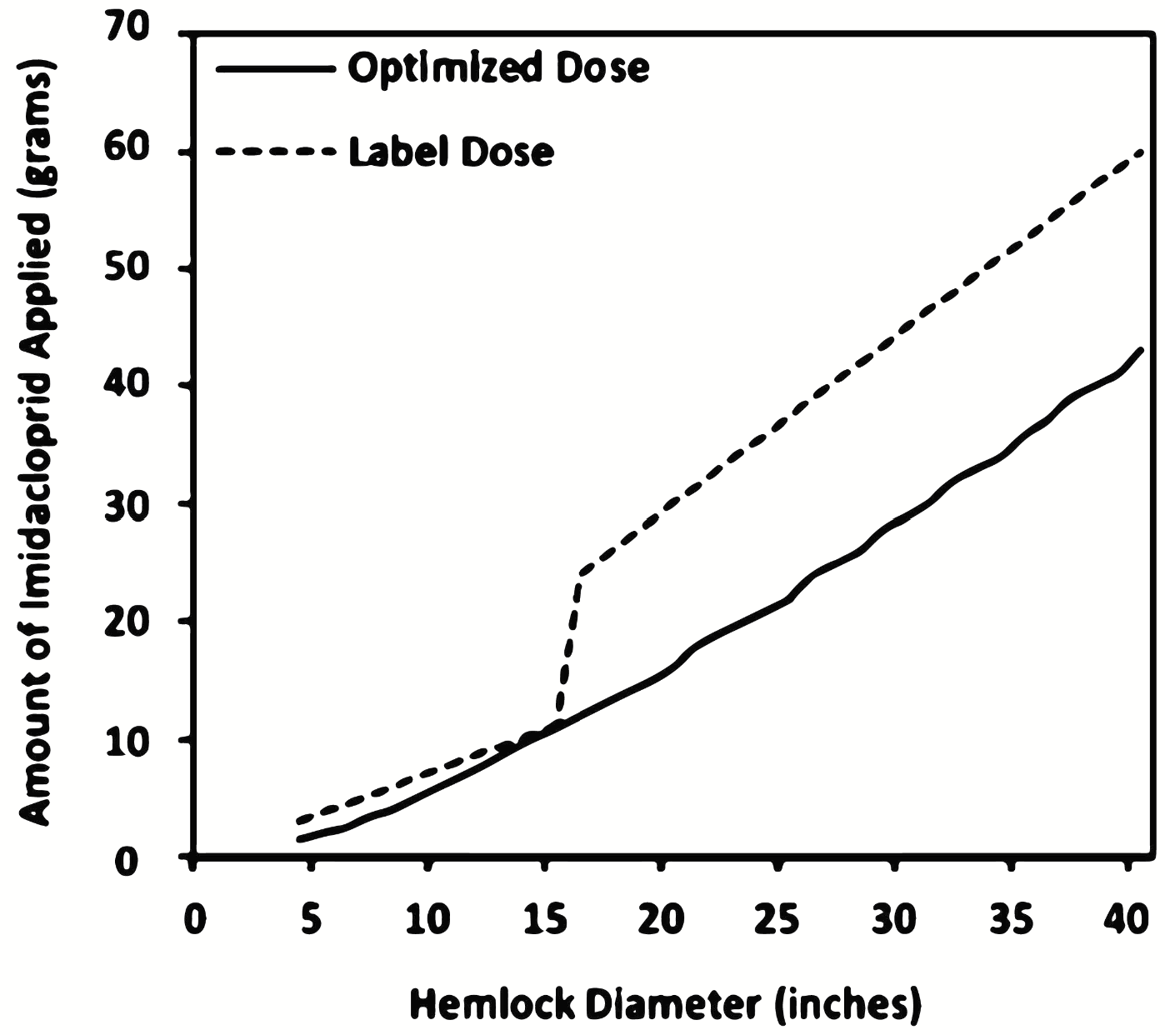
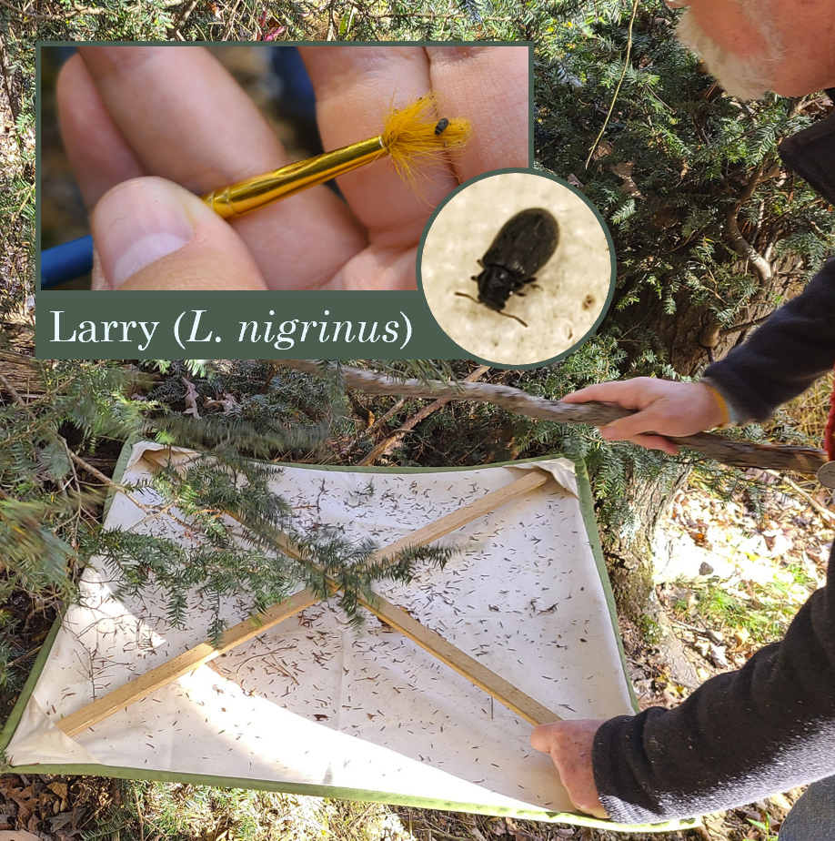
Management solutions
Benton and Cowles 2017
Lower volume & less frequent pesticide applications (Mayfield et al. 2015)
Research lowest viable treatments
(Cowles 2008, Eisenback 2014, Benton and Cowles 2017)
Expand biocontrol efforts + monitoring
(Havill et al. 2010, Jones et al. 2014, Mayfield et al. 2015, Vose et al. 2013)
Restore ecosystem function by
using other species (Vose et al. 2013)

Slide 9
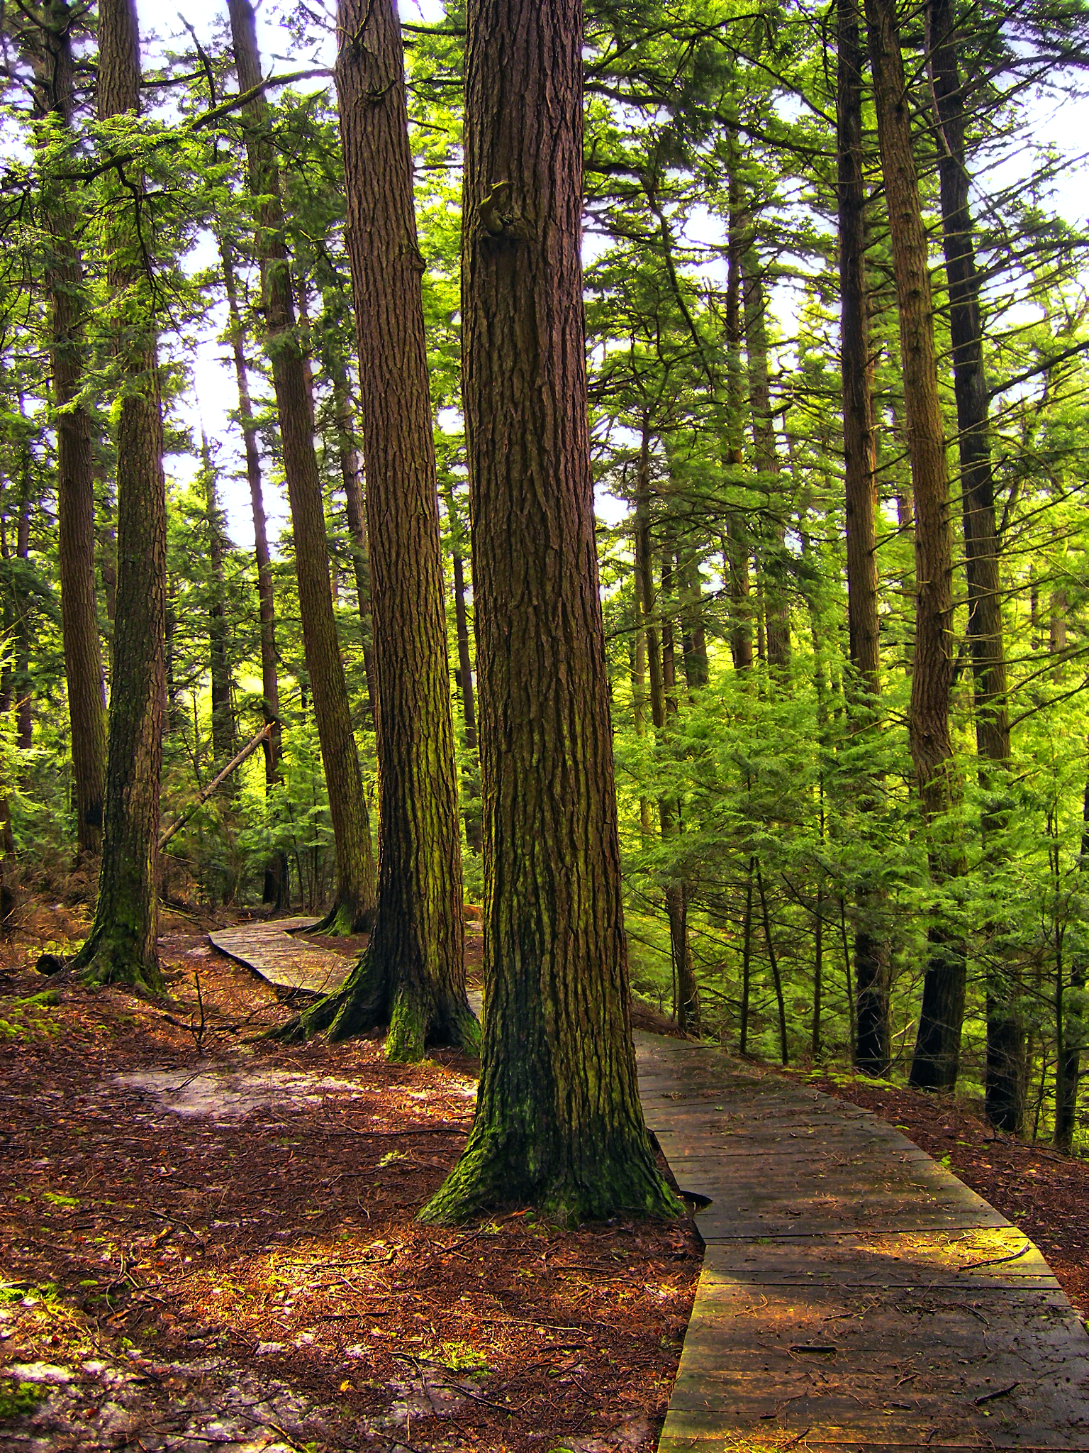
Management solutions
Integrated management:
Less-frequent pesticide application + biocontrol → reduce non-target effects + maximize tree growth
Restoration where die-off has already occurred
  Alternative species
  Genetically resistant trees

Slide 10
Conclusions
Need for ecosystem-based approach even within a bounded area like Swallow Falls State Park
Planning longer-term management (> 5-10 years),
Targeting areas of importance
Managing for a future with fewer hemlock and ash trees
Ultimately, other invasives need to also be controlled to reduce potentially detrimental dynamics (Vose et al., 2013)
Identify ecosystem threats
and challengers
Manage acute threats and mitigate non-target impacts
Research potential future dynamics
Create long-term management and restoration plans

